Slide 1


Slide 2
CONTENT
Selenium WebDriver
Selenium WebDriver- Architecture
Selenium Language Bindings
JSON Wire Protocol
Browser Drivers
Browsers
Selenium WebDriver- Features
Selenium WebDriver- Installation
Selenium WebDriver- First Test Case
Selenium WebDriver- Commands
Selenium WebDriver- Running test on Chrome Browser
Selenium WebDriver- Locating Strategies
Assertions

Slide 3
Selenium WebDriver
Selenium WebDriver is the most important component of Selenium Tool's Suite. The latest release "Selenium 2.0" is integrated with WebDriver API which provides a simpler and more concise programming interface.
The following image will give you a fair understanding of Selenium components and the Test Automation Tools.
Selenium WebDriver was first introduced as a part of Selenium v2.0. The initial version of Selenium i.e Selenium v1 consisted of only IDE, RC and Grid. However, with the release of Selenium v3, RC has been deprecated and moved to legacy package.
In WebDriver, test scripts can be developed using any of the supported programming languages and can be run directly in most modern web browsers. Languages supported by WebDriver include C#, Java, Perl, PHP, Python and Ruby.
Before learning the concepts of Selenium WebDriver, you should be well versed with any of the supported programming languages. Currently, Selenium Web driver is most popular with Java and C#. For this tutorial, we are using Selenium with java. You can refer to the links given below to learn basic as well as advance concepts of Java and C#:

Slide 4
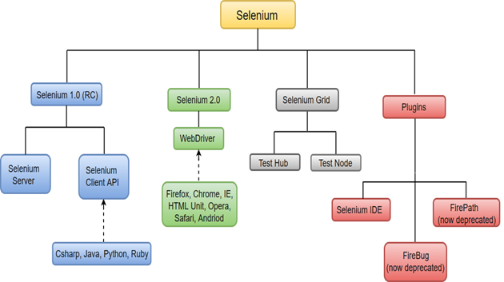
Selenium WebDriver performs much faster as compared to Selenium RC because it makes direct calls to the web browsers. RC on the other hand needs an RC server to interact with the browser.
WebDriver has a built-in implementation of Firefox driver (Gecko Driver). For other browsers, you need to plug-in their browser specific drivers to communicate and run the test. Most commonly used WebDriver's include:
Google Chrome Driver
Internet Explorer Driver
Opera Driver
Safari Driver
HTML Unit Driver (a special headless driver)

Slide 5
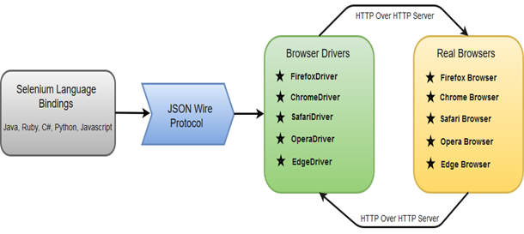
Selenium WebDriver- Architecture
Selenium WebDriver API provides communication facility between languages and browsers.
The following image shows the architectural representation of Selenium WebDriver.
There are four basic components of WebDriver Architecture:
Selenium Language Bindings
JSON Wire Protocol
Browser Drivers
Real Browsers

Slide 6
Selenium Language Bindings
Selenium developers have built language bindings/Selenium Client Libraries in order to support multiple languages. For instance, if you want to use the browser driver in java, use the java bindings. All the supported language bindings can be downloaded from the official website (https://www.seleniumhq.org/download/#client-drivers) of Selenium.

Slide 7

JSON Wire Protocol
JSON (JavaScript Object Notation) is an open standard for exchanging data on web. It supports data structures like object and array. So, it is easy to write and read data from JSON.
JSON Wire Protocol provides a transport mechanism to transfer data between a server and a client. JSON Wire Protocol serves as an industry standard for various REST web services.

Slide 8
Browser Drivers
Selenium uses drivers, specific to each browser in order to establish a secure connection with the browser without revealing the internal logic of browser's functionality. The browser driver is also specific to the language used for automation such as Java, C#, etc.
When we execute a test script using WebDriver, the following operations are performed internally.
HTTP request is generated and sent to the browser driver for each Selenium command.
The driver receives the HTTP request through HTTP server.
HTTP Server decides all the steps to perform instructions which are executed on browser.
Execution status is sent back to HTTP Server which is subsequently sent back to automation script.

Slide 9

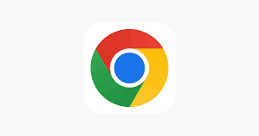


Browsers:
Browsers supported by Selenium WebDriver:
Internet Explorer
Google Chrome
Mozilla Firefox
Safari

Slide 10
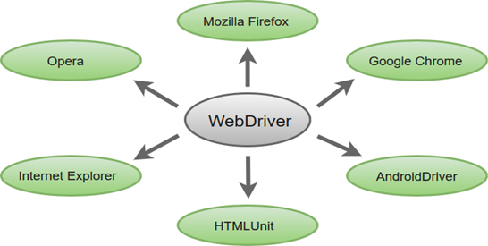

Selenium WebDriver- Features
Some of the most important features of Selenium WebDriver are:
Multiple Browser Support: Selenium WebDriver supports a diverse range of web browsers such as Firefox, Chrome, Internet Explorer, Opera and many more. It also supports some of the non-conventional or rare browsers like HTMLUnit.
Multiple Languages Support: WebDriver also supports most of the commonly used programming languages like Java, C#, JavaScript, PHP, Ruby, Pearl and Python. Thus, the user can choose any one of the supported programming language based on his/her competency and start building the test scripts.
Speed: WebDriver performs faster as compared to other tools of Selenium Suite. Unlike RC, it doesn't require any intermediate server to communicate with the browser; rather the tool directly communicates with the browser.

Slide 11
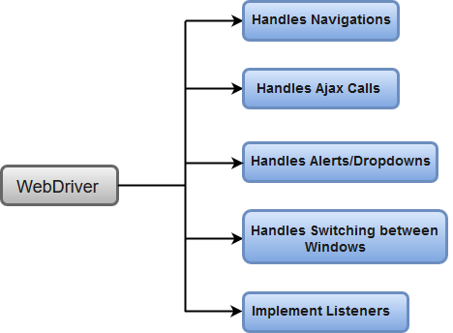
Simple Commands: Most of the commands used in Selenium WebDriver are easy to implement. For instance, to launch a browser in WebDriver following commands are used:
WebDriver driver = new FirefoxDriver(); (Firefox browser ) WebDriver driver = new ChromeDriver(); (Chrome browser) WebDriver driver = new InternetExplorerDriver(); (Internet Explorer browser)
WebDriver- Methods and Classes: WebDriver provides multiple solutions to cope with some potential challenges in automation testing. WebDriver also allows testers to deal with complex types of web elements such as checkboxes, dropdowns and alerts through dynamic finders.

Slide 12
Selenium WebDriver- Installation
Download and Install Java 8 or higher version.
Download and configure Eclipse or any Java IDE of your choice.
Download Selenium WebDriver Java Client
Configure Selenium WebDriver
Selenium WebDriver installation process is completed in four basic steps:

Slide 13
Under this test, we will automate the following scenarios:
Invoke
Invoke Google Chrome browser.
Open
Open URL: www.google.com
Click on
Click on the Google Search text box.
Type
Type the value "javatpoint tutorials"
Click on
Click on the Search button.
Selenium WebDriver- First Test Case

Slide 14
Selenium WebDriver- Running test on Chrome Browser
Launch
Launch Chrome browser.
Maximize
Maximize the browser.
Open
Open URL: www.javatpoint.com
Scroll down
Scroll down through the web page
Click on
Click on "Core Java" link from the Java Technology section.
Chrome browser implements the WebDriver protocol using an executable called ChromeDriver.exe. This executable start a server on your system which in turn is responsible for running your test scripts in Selenium.

Slide 15
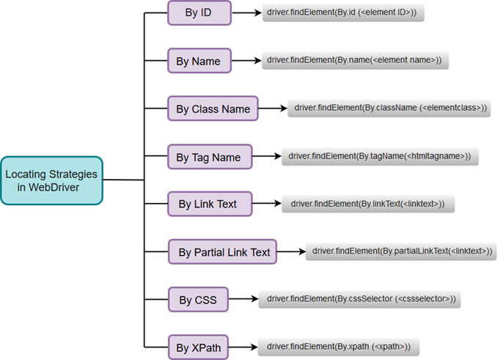
Selenium WebDriver- Locating Strategies
Just like Selenium IDE, WebDriver uses the same set of locating strategies for specifying location of a particular web element.
Since, we are using WebDriver with java; each locating strategy has its own command in Java to locate the web elements.
A list of Locating Strategies used in WebDriver:

Slide 16
Selenium WebDriver- Handling drop-downs
Select in Selenium WebDriver
selectByIndex
selectByValue
selectByVisibleText
Selenium WebDriver- Drag and Drop
Actions in Selenium WebDriver
clickAndHold(WebElement element)
moveToElement(WebElement element)
release(WebElement element)
build()

Slide 17
Selenium WebDriver- Handling Alerts
void dismiss()
void accept()
String getText()
void sendKeys(String stringToSend)
Selenium WebDriver - Browser Commands
Get Command
Get Title Command
Get Current URL Command
Get Page Source Command
Close Command
Quit Command

Slide 18
Selenium WebDriver - Navigation Commands
Navigate To Command
Forward Command
Back Command
Refresh Command
Selenium WebDriver - WebElement Commands
Clear Command
Sendkeys Command
Click Command
IsDisplayed Command
IsEnabled Command
IsSelected Command
7. Submit Command
8. GetText Command
9. GetTagName Command
10. getCssValue Command
11. getAttribute Command
12. getSize Command
13. getLocation Command

Slide 19
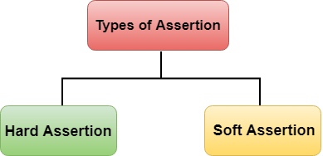
Assertions
Assertion determines the state of the application whether it is the same what we are expecting or not. If the assertion fails, then the test case is failed and stops the execution.
There are two types of Assertion:
Hard Assertion
Soft Assertion

Slide 20
Hard Assertion
Hard Assertion is an Assertion that throws the AssertException when the test case is failed. In the case of Hard Assertion, you can handle the error by using a catch block like a java exception. Suppose we have two test cases in a suite. The first test case in a suite has an assertion that fails, and if we want to run the second case in a suit, then we need to handle the assertion error. A Hard Assertion contains the following methods:
AssertEquals
AssertNotEquals
AssertTrue
AssertFalse
AssertNull
AssertNotNull
AssertFalse()
Assertion verifies the boolean value returned by a condition. If the boolean value is false, then assertion passes the test case, and if the boolean value is true, then assertion aborts the test case by an exception. Syntax of AssertFalse() method is given below:
Assert.AssertFalse(condition);

Slide 21


